Slide 1
Adaptive Web Components: Context Matters!
Elena Makarenko
SAP SE
July 18, 2018

Slide 2
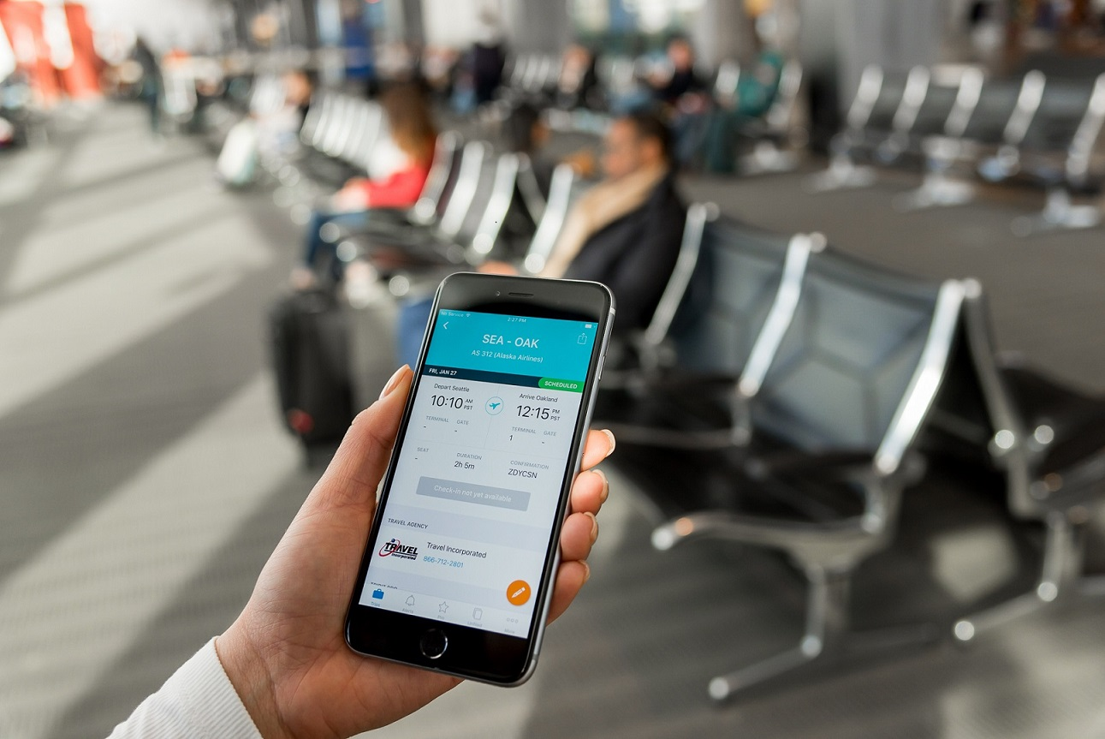
Notes:
Introduction story: travel fever

Slide 3
Extended Context
Light level
Location
Velocity
Time
Temperature
Battery charging level
…

Slide 4






Sensor Data
Native App
Browser App
Generic Sensor API

Slide 5
Adaptive Web Components (AWC)
Web Components:
Custom Elements
Shadow DOM
HTML Templates
AWC on GitHub:
https://github.com/FraunhoferIAO/awc-core
Notes:
AWC framework introduction.

Slide 6
AWC – Context Style
@context (5 < lightLevel <= 15), (55 <= lightLevel < 70) {
body {
background-color: black;
color: white;
}
}

Slide 7



AWC – Variants
Context
Person : Component
Text
Variant “text”
Graphic
Variant “graphic”
Mixed
Variant “mixed”

Slide 8


Demo: Context Styles
Ever sat in one of the shaking cable cars in San Francisco and ordered a wrong pizza because the train is rattling along so the buttons get all mixed up? …
Notes:
“Shake” Demo

Slide 9
Demo App
OpenUI5: https://openui5.hana.ondemand.com/
Adaptive Web Components: https://github.com/FraunhoferIAO/awc-core
Generic Sensor API: https://www.w3.org/TR/generic-sensor/

Slide 10
1 - Context queries
<context-style >
@context (vibrationLevel > 0){
.sapMBtn.ui5-awc_adaptiveButton .sapMBtnContent {
padding: 1.5rem;
font-size: 1.2rem;
} ...
}
@context (vibrationLevel > 1){
.sapMBtn.ui5-awc_adaptiveButton .sapMBtnContent {
padding: 2.5rem 0;
font-size: 1.5rem;
} ...
}
</context-style>

Slide 11
2 – AWC Profile Store
var oProfileStore = new awc.ProfileStore(true);
oProfileStore.changeProfile({
"vibrationLevel": iValue
});

Slide 12
3 – Sensor Event handler
var sensor = new Accelerometer({frequency: 60});
sensor.start();
sensor.addEventListener('reading', function () {
var iVibrationLevel = processSensorData();
oProfileStore.changeProfile({
"vibrationLevel": iVibrationLevel});
}.bind(this));

Slide 13
Demo: Adaptive Variants
Notes:
Demo 2: Traveller app – time context

Slide 14
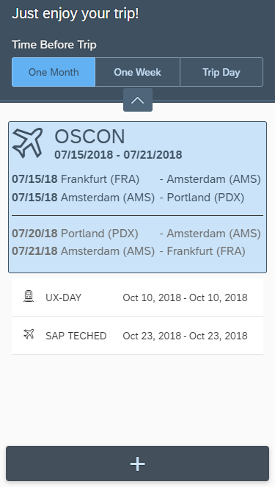
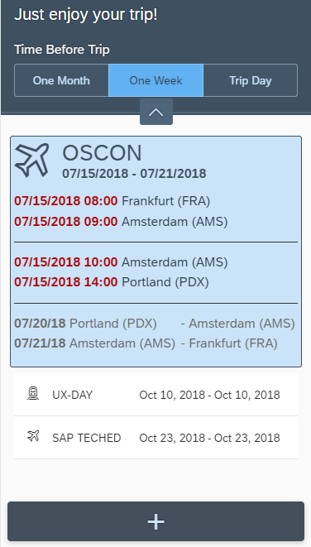
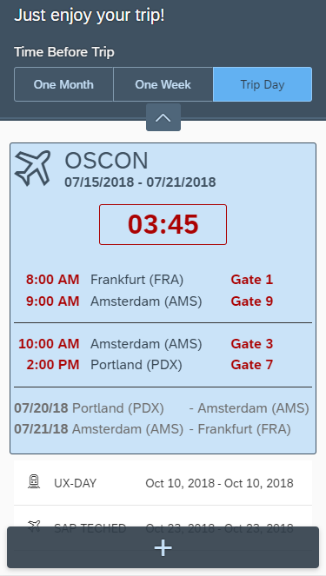

Traveler App
Notes:
App concept

Slide 15
Live Coding

Slide 16
Demo Apps
Context Style
Demo: https://github.com/mak-elena/ui5-awc-shakeDemo
GitHub: https://github.com/mak-elena/ui5-awc-shakeDemo
Adaptive Variants
Demo: https://mak-elena.github.io/ui5-awc-variantsDemo/
GitHub (initial state): https://github.com/mak-elena/ui5-awc-variantsDemo/tree/initial
GitHub (final state): https://github.com/mak-elena/ui5-awc-variantsDemo

Slide 17
Resources
OpenUI5:
https://openui5.hana.ondemand.com/
Adaptive Web Components (AWC): https://github.com/FraunhoferIAO/awc-core
Generic Sensor API:
https://www.w3.org/TR/generic-sensor/
Generic Sensor API Demo: https://intel.github.io/generic-sensor-demos/

Slide 18
Thank you!
Elena Makarenko, SAP SE
Elena.Makarenko@sap.com
July 18, 2018

